Slide 1
WAVE OPTICS
Lecture 1: Electromagnetic nature of light

Slide 2
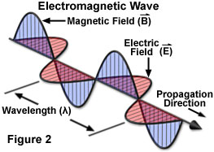
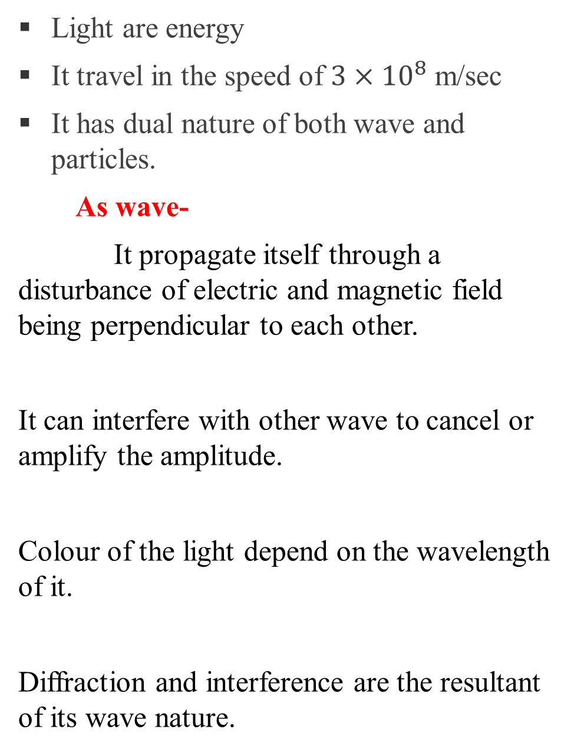
PROPERTIES OF LIGHT
Light are energy
It travel in the speed of $3×{10}^{8}$ m/sec
It has dual nature of both wave and particles.
As wave-
It propagate itself through a disturbance of electric and magnetic field being perpendicular to each other.
It can interfere with other wave to cancel or amplify the amplitude.
Colour of the light depend on the wavelength of it.
Diffraction and interference are the resultant of its wave nature.

Slide 3

As particle
Light has quantized particle called photon which travel through the space.
Photon has specific or quantized energy thus light is also quantized.
Photoelectric effect, scattering are some consequence of its particle nature.

Slide 4
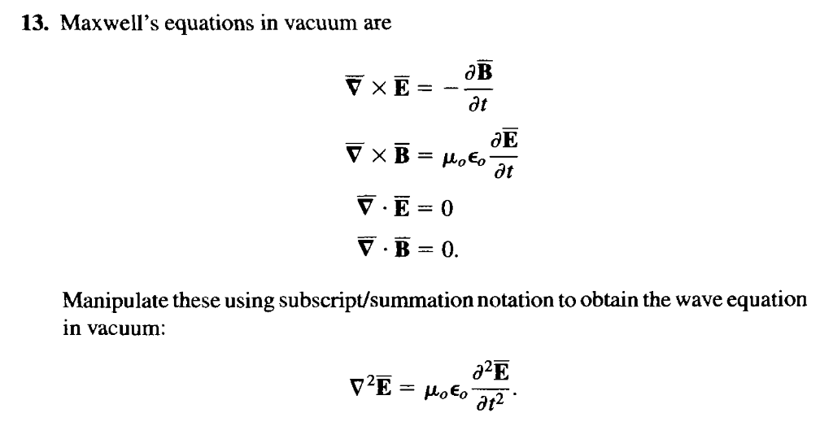
Electromagnetic nature of the light
Electromagnetic radiation consist of electric and magnetic field mutually perpendicular to the direction of it propagation.
Maxwell equation beautifully prove the manifestation of electromagnetic nature of light.

Slide 5
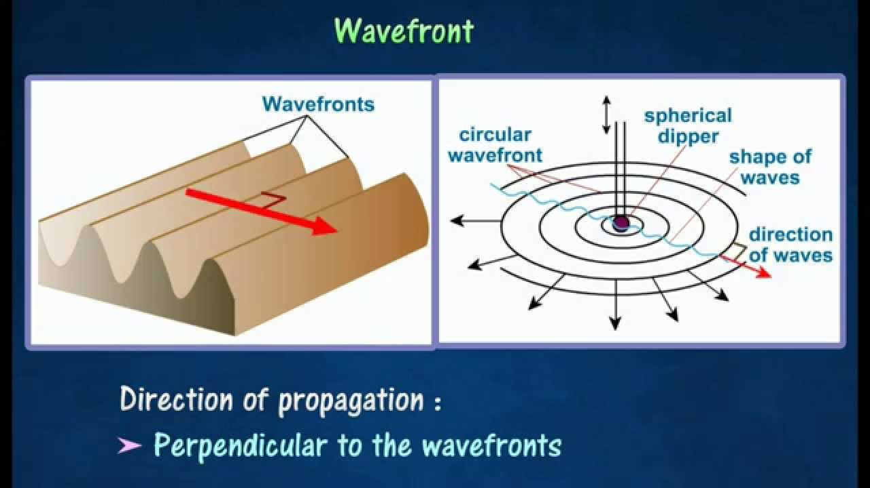
WAVEFRONT
Definition :- wavefront is the locus of the all the points having same phase at a given instant.
For waves propagating in 1D wavefront is point, 2D it is curve and in 3D it is surface.

Slide 6
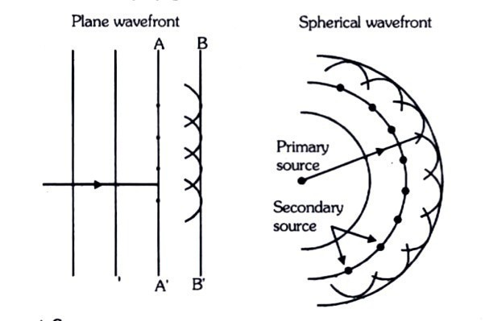
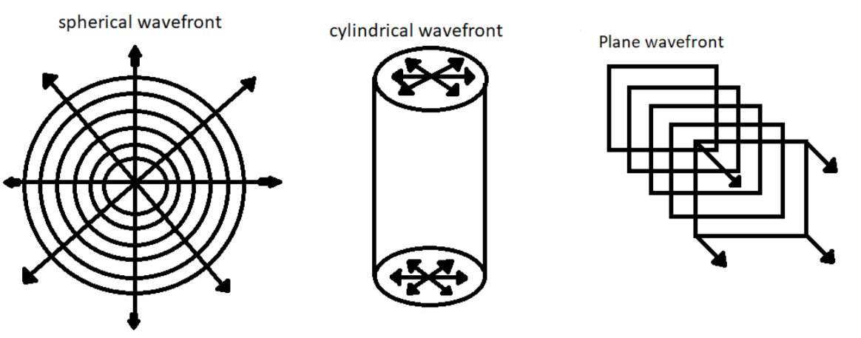
Different wavefronts

Slide 7
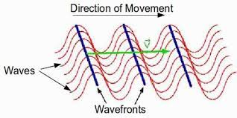
It’s properties
For a EM wave, wavefront is always perpendicular to the ray which denotes the direction of the propagation.
At every point the plane containing electric and magnetic field vector for an EM wave, is tangential to the wavefront.
Wavefront is not a stationary object. It propagates along the direction of propagation of the wave with a velocity same as that of the wave.

Slide 8
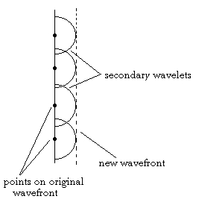
Huygens principle
Huygens’ principle stated that all points of a wave front of light in a vacuum or transparent medium may be regarded as new sources of wavelets that expand in every direction at a rate depending on their velocities
or
Every point on a wave-front may be considered a source of secondary spherical wavelets which spread out in the forward direction at the speed of light. The new wave-front is the tangential surface to all of these secondary wavelets.

