Slide 1
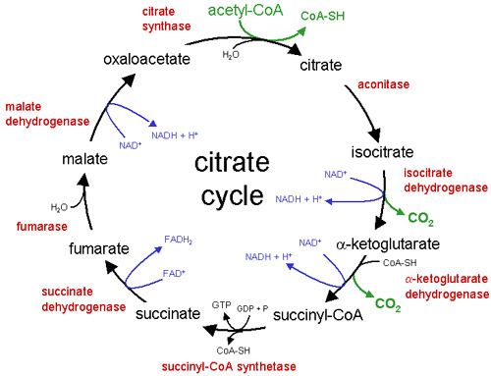
Images of TCA cycle

