Slide 1
Phases of Plant Growth
By
Dr. Rakhi Bhattacharyya

Slide 2
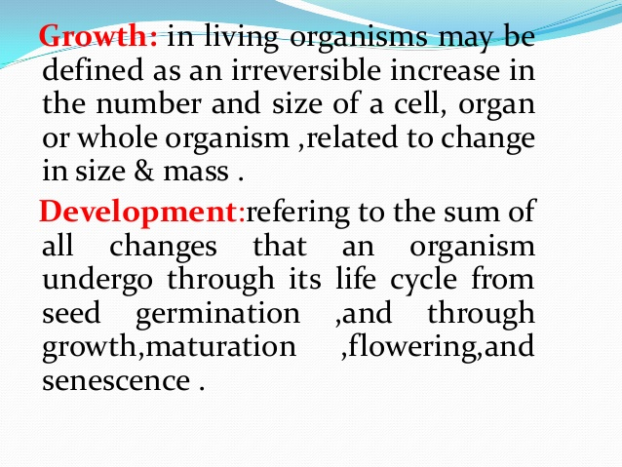

Slide 3
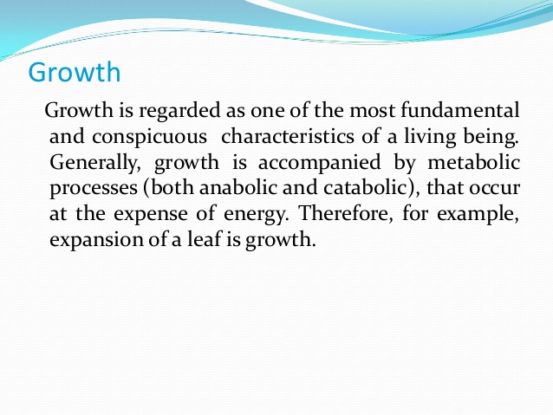

Slide 4
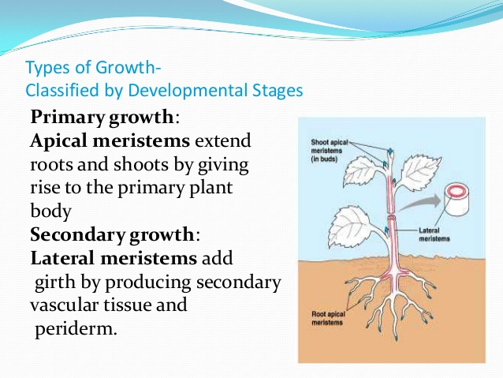

Slide 5
