Slide 1
VIRUSES, VIROIDS & PRIONS

Slide 2
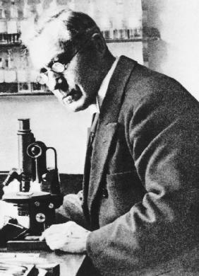
Discovery of Viruses
Beijerinck (1897) coined the Latin name “virus” meaning poison
He studied filtered plant juices & found they caused healthy plants to become sick

Slide 3
Introduction
Viruses, viroids, and prions
Acellular (noncellular)
Disease-causing agents
Lack cell structure
Cannot metabolize, grow, reproduce, or respond to their environment.
They must recruit the cell's metabolic chemicals and ribosomes in order to increase their numbers

Slide 4
Viruses
A virus is a miniscule, acellular, infectious agent
It has one or several pieces of nucleic acid -either DNA or RNA, but never both.
Viruses have no cytoplasmic membrane, and with one exception lack organelles and cytosol.
In its extracellular state, a virus is called a virion.
It consists of a protein coat, called a capsid, surrounding a nucleic acid core.
Together the nucleic acid and its capsid are called a nucleocapsid.
Some virions have a phospholipid membrane called an envelope surrounding the nucleocapsid.
When a virus penetrates a cell, the intracellular state is initiated; the capsid is removed.
A virus without a capsid exists solely as nucleic acid but is still referred to as a virus.

Slide 5
Genetic Material of Viruses
The genome of viruses includes either DNA or RNA, but never both.
In addition, they may be double-stranded (ds) or single-stranded (ss).
Thus, viral genomes are described as dsDNA, ssDNA, dsRNA, or ssRNA .
They may exist as multiple linear molecules of nucleic acid, or circular and singular molecules of nucleic acid, depending on the type of virus.
Viral genomes are usually much smaller than the genomes of cells. The smallest chlamydiaI bacterium has almost 1000 genes; the genome of bacteriophage MSZ has only three genes.

Slide 6
Hosts of Viruses
Most viruses infect only particular kinds of cells.
This specificity is due to the affinity of viral surface proteins or glycoproteins for complementary proteins or glycoproteins on the surface of the host cell.
A virus that infects bacteria is referred to as a bacteriophage, or simply a phage.
Viruses also infect humans, other animals, plants, and even fungi.

Slide 7
Sizes of Viruses
Viruses are so small that most cannot be seen by light microscopy.
The smallest have a diameter of 10 nm, whereas the largest are approximately 400 nm, about the size of the smallest bacterial cell.
CAPSID MORPHOLOGY
The capsid of a virus is composed of proteinaceous subunits called capsomeres. These may be composed of only a single type of protein, or of several different protein molecules.

Slide 8
VIRAL SHAPES
There are three basic types of viral shapes:
Helical viruses have capsomeres that spiral around the nucleic acid, forming a tube-like structure;
Polyhedral viruses are roughly spherical, with a shape similar to a geodesic dome; and
Complex viruses have capsids of many different shapes.

Slide 9
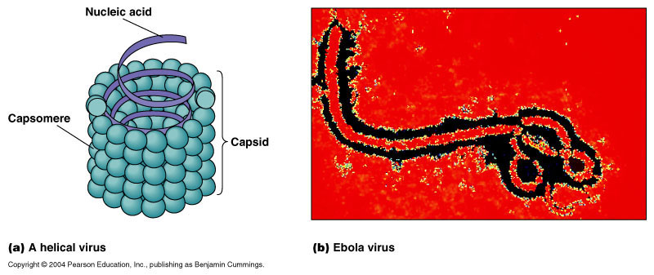
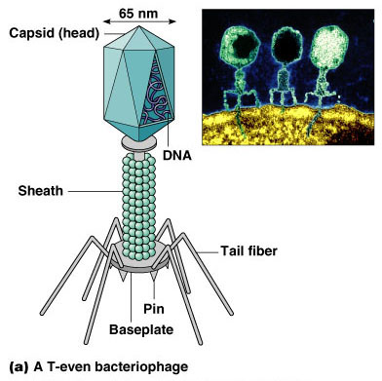
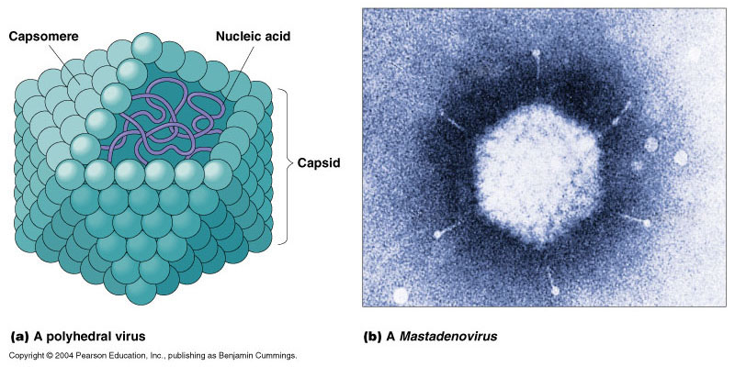

Slide 10
THE VIRAL ENVELOPE
Some viruses have a membrane similar in composition to a cell membrane surrounding their capsids. This membrane is called an envelope.
A virus with a membrane is called an enveloped virion.
A virion without an envelope is a nonenveloped or naked virion.

Slide 11
Viroids & Prions

Slide 12
Viroids
Theodor Diener discovered Viroids In 1971
An acellular particle meaning “virus-like.”
Viroids consist only of a short strand of circular RNA capable of self-replication.
Unlike viruses, viroids do not have a protein coat to protect their genetic information.

Slide 13
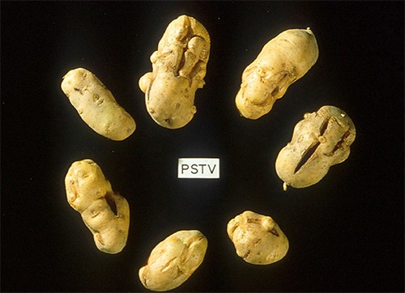
Viroid Diseases
Potato tuber spindle disease, which causes slower sprouting and various deformities in potato plants
Tomato planta macho viroid (TPMVd) infects tomato plants, which causes loss of chlorophyll, disfigured and brittle leaves, and very small tomatoes, resulting in loss of productivity in this field crop.
Avocado sunblotch viroid (ASBVd) results in lower yields and poorer-quality fruit. ASBVd is the smallest viroid discovered that infects plants.

Slide 14
Prions
Prions are “infectious proteins”
In 1982, Stanley Prusiner, a medical doctor discovered prions (received the Nobel Prize in Physiology or Medicine in 1997.)
Proteins are acellular hence….
Do not contain DNA or RNA.

Slide 15
Prions
A prion is a misfolded rogue form of a normal protein (PrPc).
PrPsc may be caused by a genetic mutation or occur spontaneously
PrPsc can be infectious,
They can stimulate other endogenous normal proteins to become misfolded.

Slide 16
Prion Diseases
Prions cause various forms of transmissible spongiform encephalopathy (TSE) in human and animals.
TSE affects the brain and nervous system.
It causes the brain tissue to become sponge-like
Kills brain cells
Forms holes in the tissue
Leads to brain damage, loss of motor coordination, and dementia.
Infected individuals are mentally impaired and become unable to move or speak.
There is no cure, and the disease progresses rapidly, eventually leads to death.

Slide 17
TSEs in humans include kuru, fatal familial insomnia, Gerstmann-Straussler-Scheinker disease, and Creutzfeldt-Jakob disease.
TSEs in animals include mad cow disease, scrapie (in sheep and goats), and chronic wasting disease (in elk and deer).
TSEs can be transmitted between animals and from animals to humans by eating contaminated meat or animal feed.

