Slide 1
Operon system

Slide 3
Contents
Introduction
Operon component
Type of Operon
Lac operon
Tryptophan operon
Arabinose operon

Slide 4
Introduction
Operon is an operating unit which can be defined as the cluster of genes located together on the chromosomes and transcribed together .
It is group of closely linked structural genes and associated control gene which regulate the metabolic activity.
The classical operon model was formulated by Jacob and Monod in 1961.

Slide 5
Operon component
Promoter
--Region on DNA where RNA Polymerase binds to start transcription.
--Acts as the on/off switch for genes.
Operator
--Region on DNA that controls access of RNA Polymerase to genes.
--Can activate or repress transcription.
Structural genes
--Genes to be transcribed by RNA Polymerase.

Slide 6
Types of Operon
Inducible : Initial condition off
Inducer Switches operon on.
Example : Lac-operon
Repressible : Initial condition on
Repressor Switches operon off.
Example : Trp-operon

Slide 7
Lac-operon
The Lactose operon designated as Lac-operon.
The Lac-operon codes for enzymes invovled in the catabolism of lactose.
Lactose is the disaccharide which is made up of glucose and galactose.
It is the inducible operon since the presence of lactose induce the operon to switch on.

Slide 8
Structure of Lac-Operon
Regulatory gene:
  Regulatory gene is the i gene that code for the repressor protein.
  This i gene is expressed in all the time hence it is also known as constitutive gene.
Structural gene:
  Three structural gene Lac z, Lac y, Lac a involved in the synthesis of enzymes for the lactose catabolism.
  The 3 genes as Transcribed in a polycistronic mRNA.
  Lac z code for Betagalactosidase.
  Lac y code for Lac permease.
  Lac a code for Transacetylase.
Promoter
Operator

Slide 9
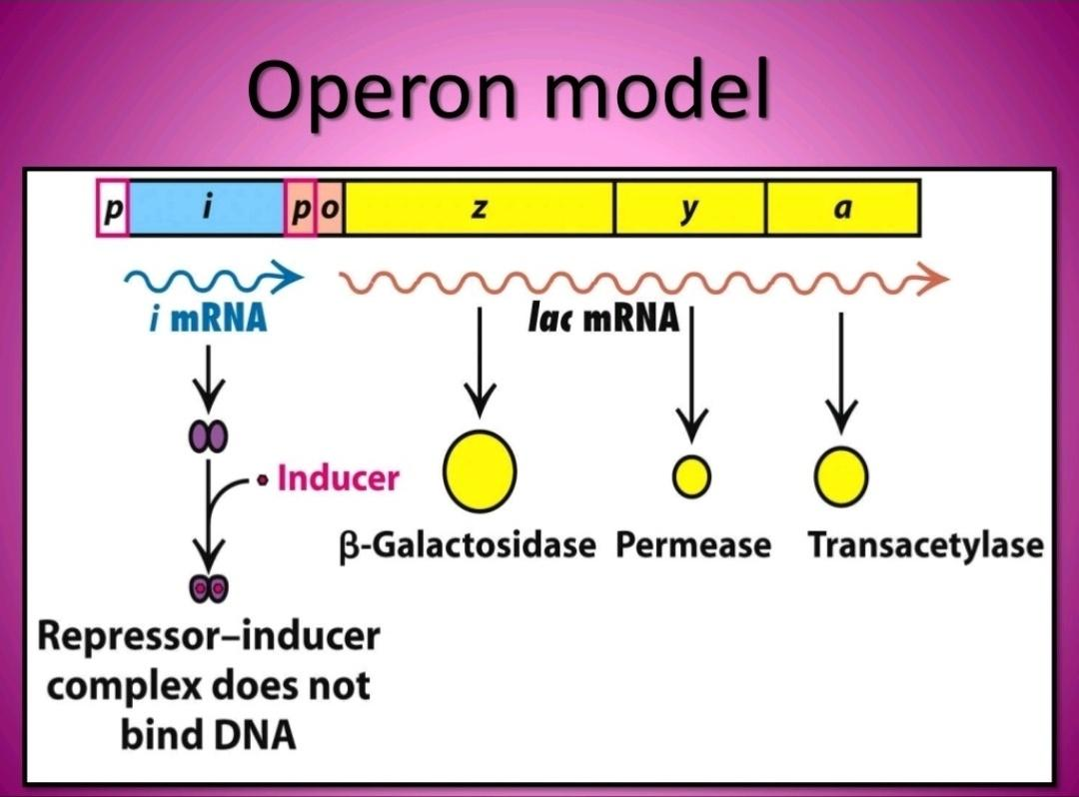

Slide 10
Negative control of Lac-operon
The lac repressor is synthesized through the activity of Lac i gene called the regulator gene.
This repressor is an allosteric protein ( a protein whose shape is changed when it binds a particular molecule)
  It binds the operator site
  It binds the lactose sugar (inducer).

Slide 11
In the abesence of Inducer , DNA binding site of repressor is functional.
The repressor protein binds to the DNA at the operator site and blocks the transcription of lac genes by RNA Polymerase.
The lac enzyme synthesis is inhibited.

Slide 12
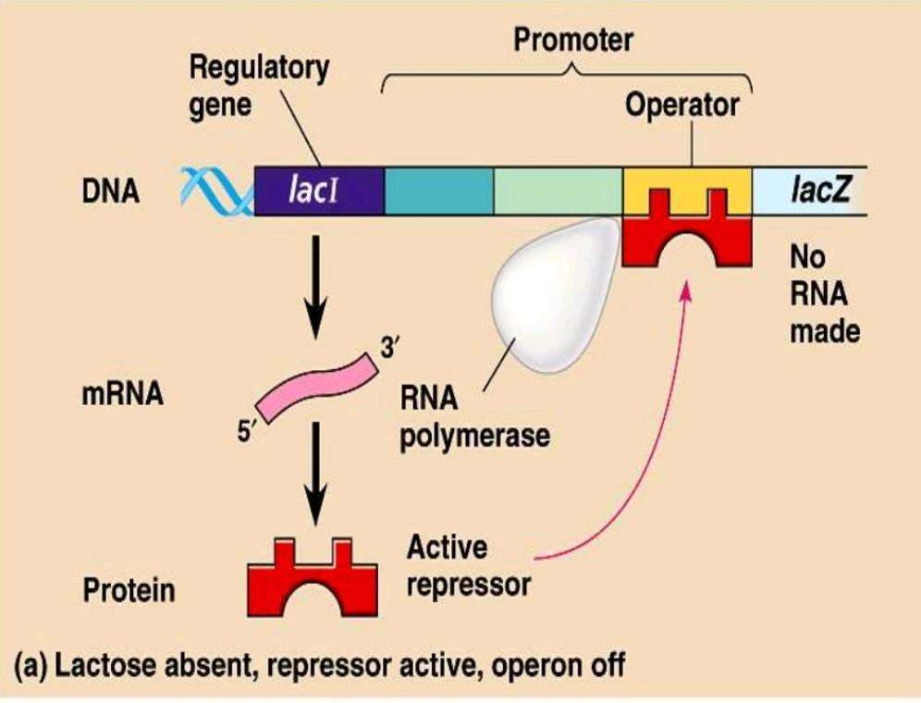

Slide 13
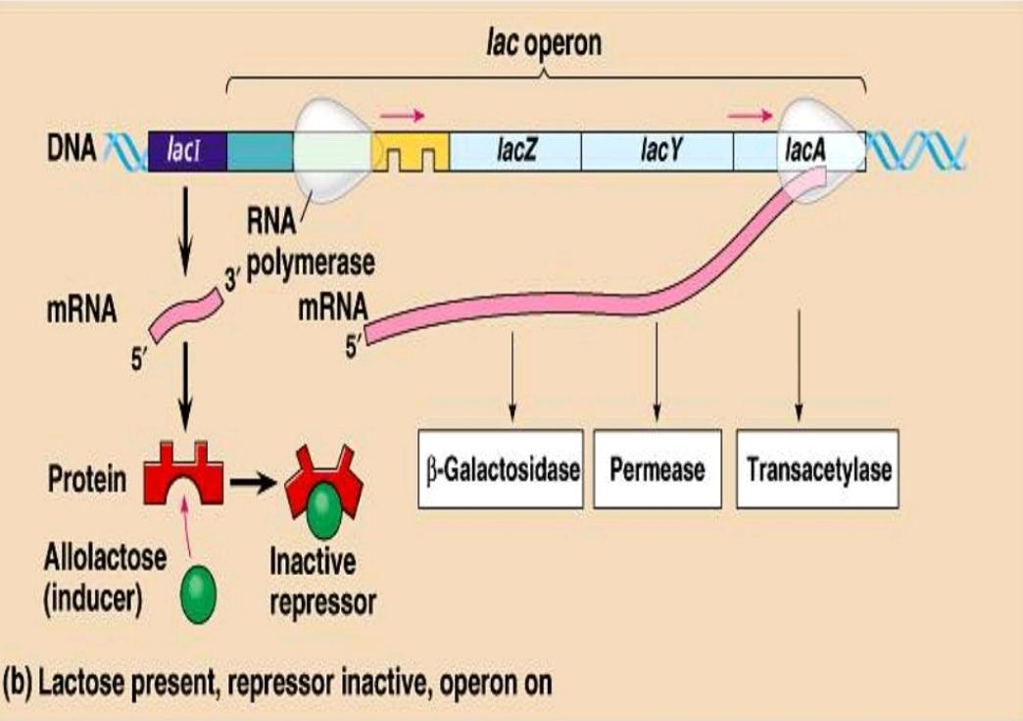

Slide 14
Positive control of Lac-operon
It is an additional regulatory mechanism which allows the lac operon to sencs the presence of glucose, an alternative and preffered energy source to lactose.
If glucose and lactose are both present, cells will use up the glucose first.
The presence of glucose in the cell switch off the lac operon by a mechanism called catabolite repression, which involved a protien called Catabolite Activator Protein (CAP).

Slide 15
CAP only binds in the presence of derivative of ATP called cyclic Adenosine Monophosphate (cAMP).
CAP binds to a DNA sequence upstream of the lac promoter and enhances binding of the RNA Polymerase.
Transcription of the operon is enhanced.

Slide 16
  cAMP levels are influenced by glucose.
  The enzyme Adenylate cyclase catalyze the formation of cAMP and is inhibited by glucose.
  When glucose is available in the cell, Adenylate cyclase is inhibited and cAMP levels are low.
  Under this condition CAP does not bind upstream of the promoter and lac operon is transcribed at very low level.

Slide 17
When glucose is low, adenylate cyclase is not inhibited, cAMP is higher and CAP binds increasing the level of transcription.
If lactose and glucose are present together , the lac operon will only transcribed at a low level.

Slide 18
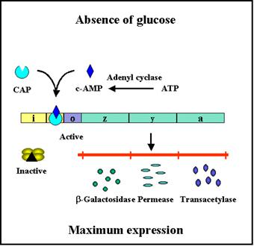

Slide 19
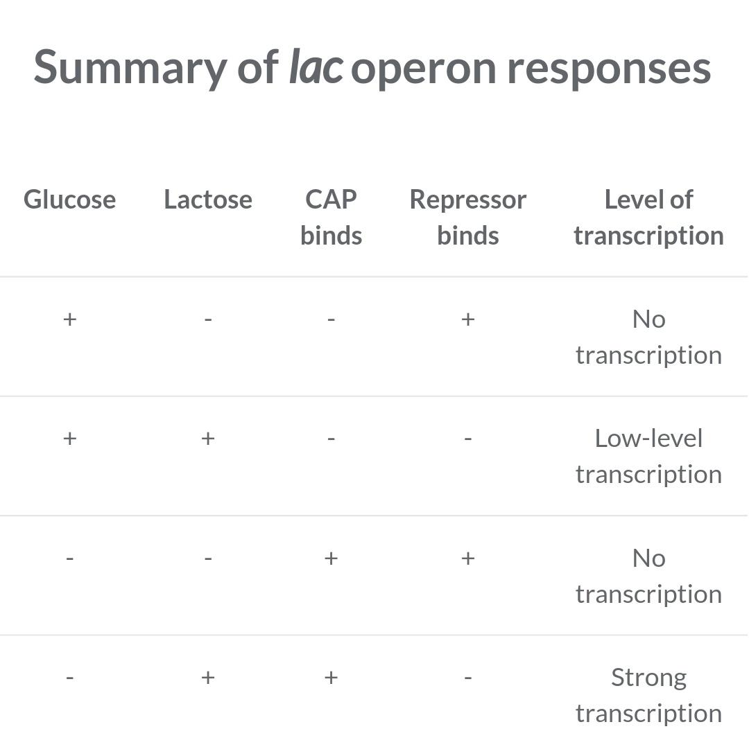

Slide 20
The Tryptophan-operon
The genes of the Trp operon are used to make the amino acid Tryptophan.
It is turned off when enough tryptophan is in the cell.
Tryptophan is the effector molecule.
Operon codes for 5 genes in bacteria.
Five polypeptides combine to make three enzymes.
Each enzyme participate in a step to make tryptophan.

Slide 21
Structure of Trp operon
Repressor gene : TrpR act as repressor gene.
Regulatory region :
    --Promoter
    --Operator
    --Attenuator (leader region)
Structural genes :
    -- trp E, trp D, trpC, trpB, trp A

Slide 22
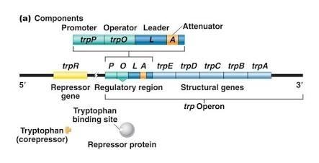
Trp operon

Slide 23
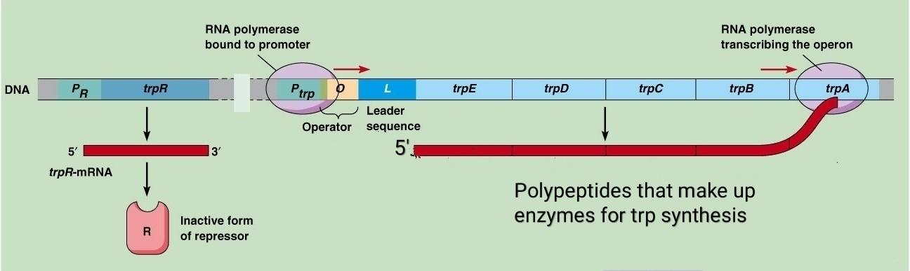
Regulation of trp operon
In the absence of tryptophan.
An inactive Repressor is made that cannot bind to the operator (O), thus allowing transcription to proceed.

Slide 24
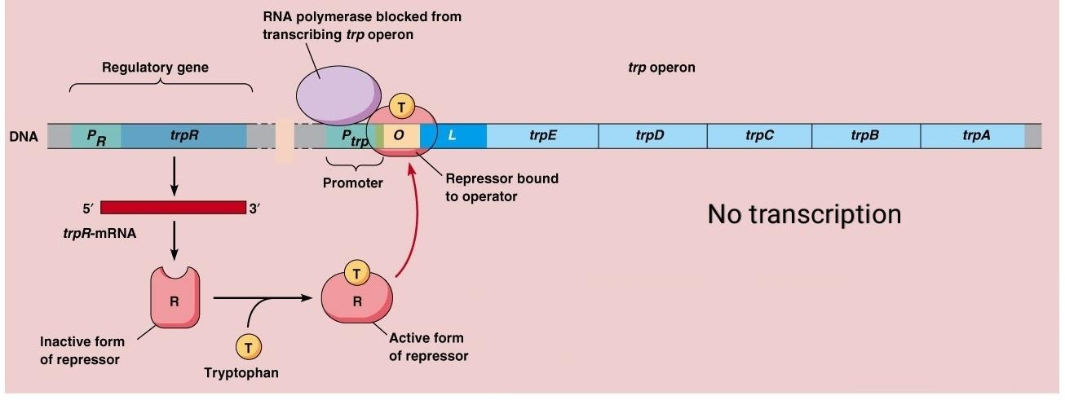
In the presence of tryptophan:
Tryptophan binds to the repressor, causing an allosteric transition to occur. This complex binds to the operator region, leading to repression of the Operon.

Slide 25
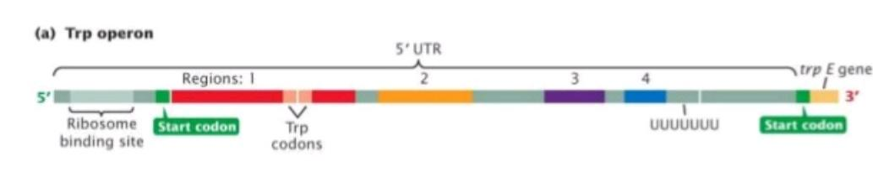
Attenuation in the trp operon
The leader region of the mRNA contains :
  Translation start codon (AUG)
  Two tryptophan codon (UGGUGG)
  String of U residues at the end of the leader.

Slide 26
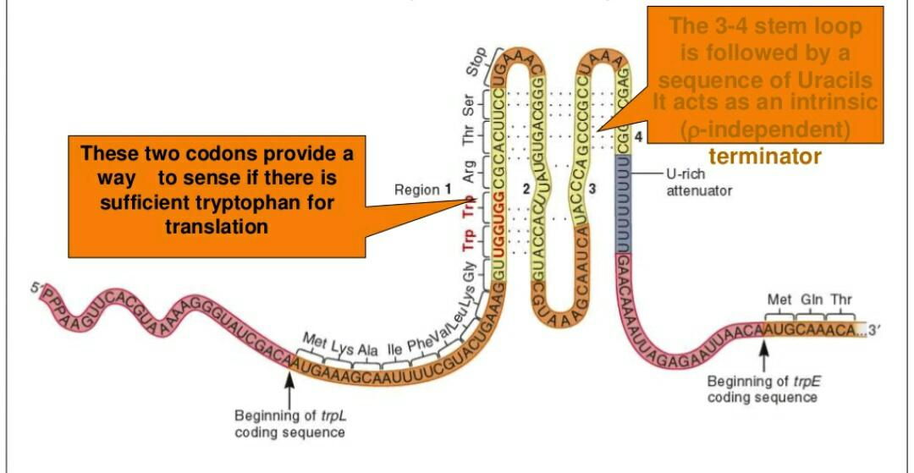
The four regions marked 1,2,3 & 4 indicate the location of four sequences that have the potencial to form stems by base pairing.
Region 2 is complementary to regin 1 and 3.
Region 3 is complementary to region 2 and 4.
  --therefore several stemloop structures are possible.
        Sequence of the trpL mRNA produced during attenuation

Slide 27
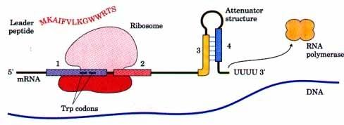
When tryptophan levels are high, the ribosome quickly translate sequence 1(open reading frame encoding leader peptide) and blocks sequence 2 before sequence 3 is transcribed. Continued transcription leads to attenuation at the terminator like structure formed by sequences 3 and 4.

Slide 28
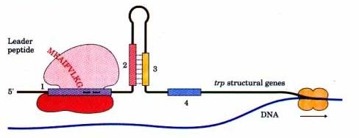
When tryptophan levels are low, the ribosome pauses at the Trp codons in sequence 1. Formation of the paired structure between sequences 2 and 3 prevents attenuation because sequence 3 is no longer available to form the attenuator structure with sequence 4.

Slide 29
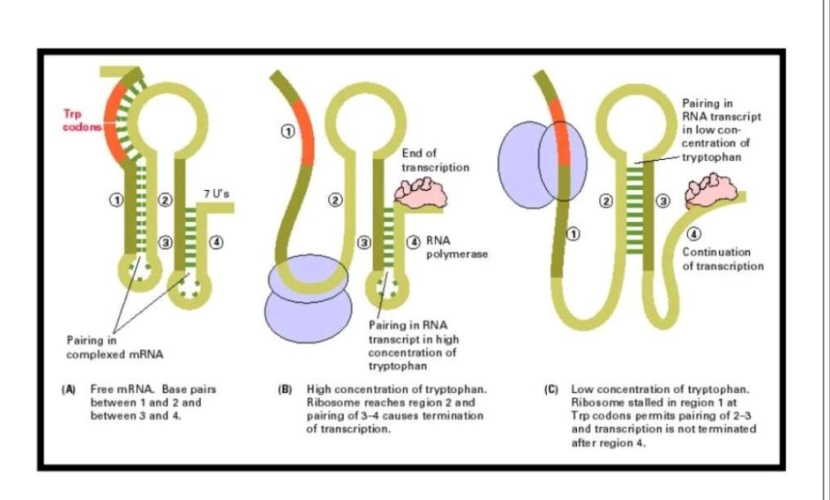

Slide 30
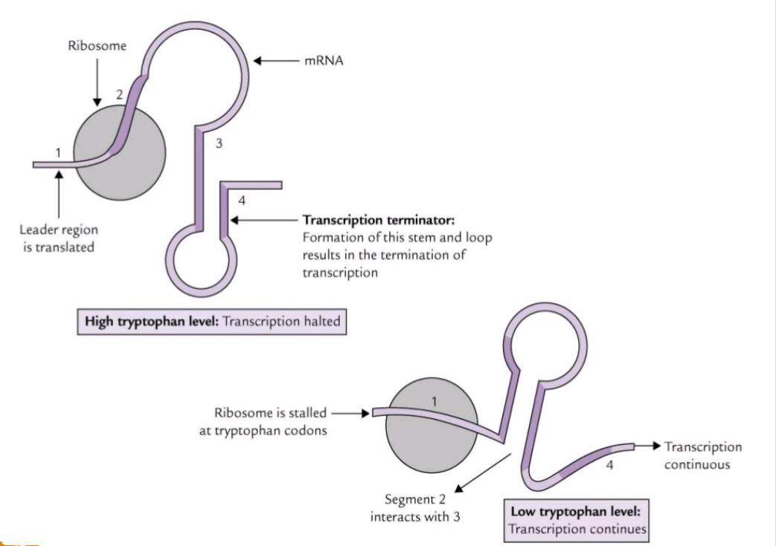

Slide 31
The lack of tryptophan causes ribosomes to stall at these codons, covering region of the mRNA required for formation of the attenuation hairpin.
This prevents attenuation and thus allows transcription continue.

Slide 32
Arabinose operon
The three structural genes (araB, araA, araD) encode for enzymes needed for the metabolism of the sugar arabinose in bacterial cells.
araB, araA and araD encode for enzymes kinase, isomerase and epimerase.
Isomerase converts arabinose to ribulose.
Kinase converts ribulose to ribulose-5-phosphate.

Slide 33
The arabinose operon also contains the Arabinose C gene which produce araC protein.
The araC gene regulates the expression of the structural genes and the araC protein.
Thus, the araC gene is autoregulated.
The presence of both arabinose and araC gene product activate the expression of the BAD genes.

Slide 34
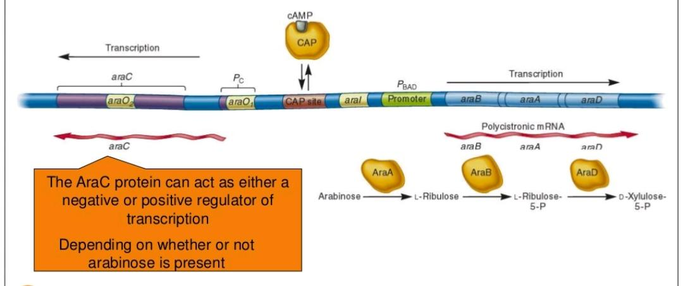
The araC gene is adjacent to the ara operon.
    --It has its own promoter, Pc
    --It encodes a regulatory protein, AraC.
    --AraC can binds to three different operator sites,
    designated as araI, araO₁ and araO₂

Slide 35
Negative regulation of ara operon
When Arabinose is absent, the AraC protein acts as a negative regulator.
AraC acts as a dimer and causes the DNA loop.
Looping brings araI and araO₂ sites in proximity to one another.
One araC monomer binds to araI and a second monomer binds to araO₂
Binding of araC prevents RNA Polymerase from binding to the P_{BAD} promoter.
Transcription not occur.

Slide 36
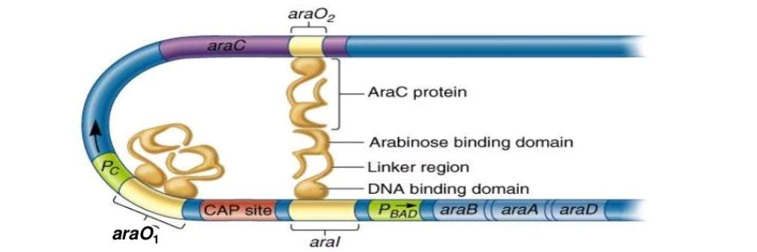
Operon inhibited in the absence of Arabinose:

Slide 37
Positive regulation of ara operon
When Arabinose is present, it binds to AraC protein and changes AraC conformation.
An arabinose-AraC dimer complex binds preferentially to AraI and not to the AraO₂ which causes ‘opening’ of the loop.
This allows RNA Polymerase to bind to P_{BAD}
If glucose levels are low, cAMP-CAP complex binds to P_{C} and active the transcription.

Slide 38
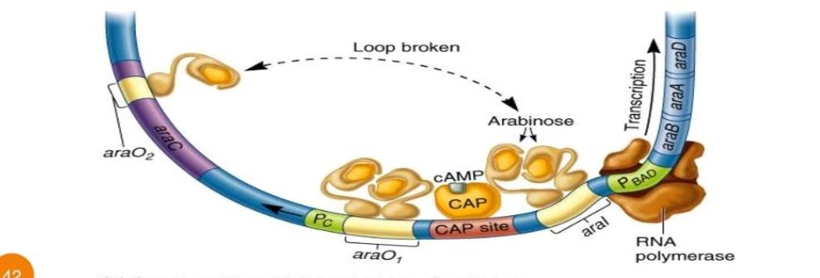
Operon activated in the presence of Arabinose :

Slide 39
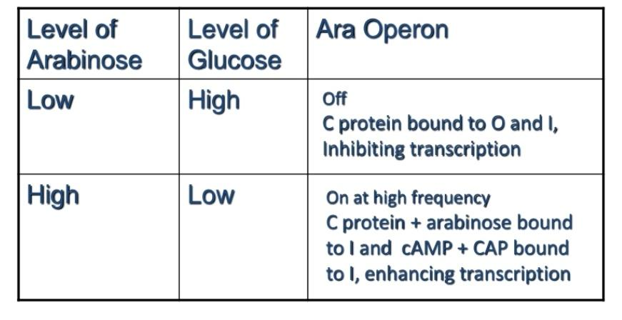
Summary of ara operon regulation

Slide 40
Reference
The lac operon (article) | Gene regulation | Khan Academy https://www.khanacademy.org › biology
The trp operon (article) | Gene regulation | Khan Academy https://www.khanacademy.org › biology
Genetics – Verma & Agarwal
Genetics – Rastogi
Google images

Slide 41
Thank you

