Slide 1

Binod Goswami, Nowgong Girls’ College
SHARING OF TAX BETWEEN BUYERS AND SELLERS

Slide 2

Perfect Elastic Demand Curve and Normal Supply Curve
ENTIRE TAX BURDEN WILL BE ON SELLERS
Y
P1 P
d
O Q1 Q x
S1
s
d

Slide 3
2. INELASTIC SUPLLY CURVE AND NORMAL DEMAND CURVE
ENTIRE TAX BURDEN ON SELLERS
S=St
Y
P
O
D
X
Q

Slide 4
3.PERFECTLY ELASTIC SUPPLY CURVE AND NORMAL DEMAND CURVE
ENTIRE TAX BURDEN ON BUYERS
y
Pt
St
P
S
D
X
O
Qt
Q

Slide 5

4.INELASTIC DEMAND CURVE AND NORMAL SULLPY
ENTRIRE BURDEN WILL BE ON BUYERS
St
Y
D
S
Pt
P
O
Q
X

Slide 6

IN REAL PRACTICE NO ONE COMMODITY HAS PERFECTLY ELASTIC OR PERFECTLY INEASTIC DEMAND OR SUPPLY
Most of the commodities have normal demand and supply and hence the demand and supply curve take normal shape that is .
Demand curve is slopping downward from left to the right
    and
Supply curve is slopping upward from left to the right
0<Elasticity <α

Slide 7
Sharing of tax between buyers and sellers when E_{s} and E_{d} is greater than 0 but less than α
St
Y
S
BUYER
Pt
TAX
p
SELLER
D
O
X
Qt
Q

Slide 8
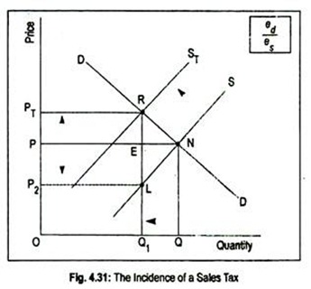
IF E_{d} >Es, MORE BURDEN WILL BE ON SELLER

